Slide 1
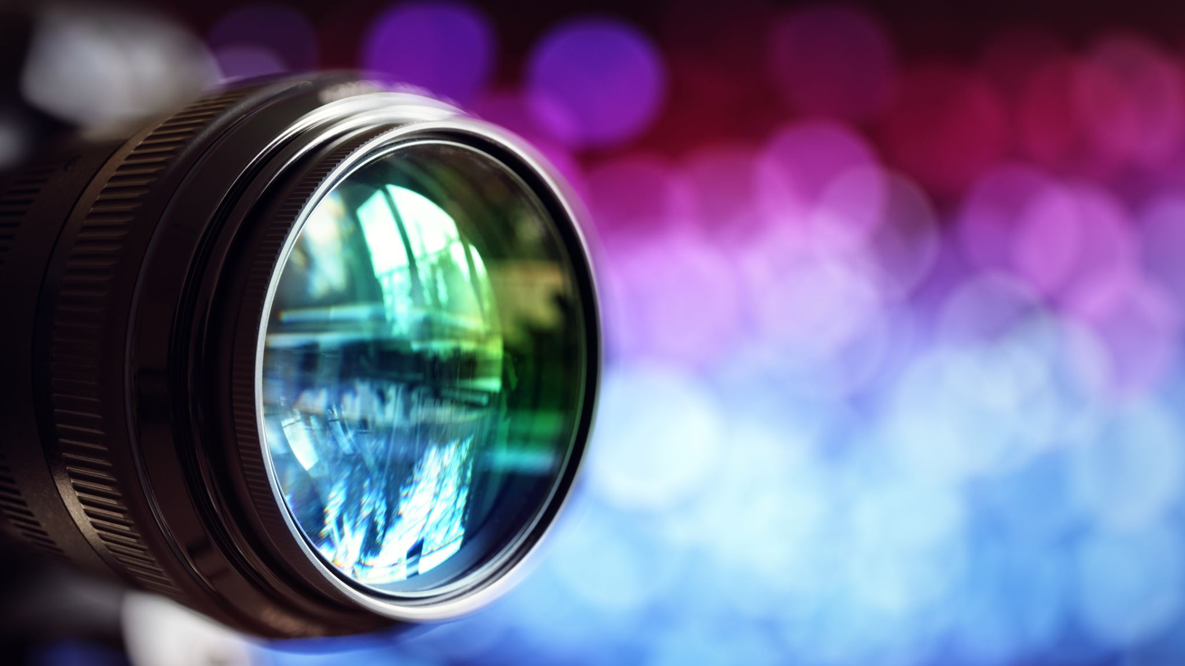
Color Film Auto-Fixer
By: Ben Blanquart

Slide 2
Problem
Digital scans of film usually don't look right
The process of editing them is tedious to do manually

Slide 3


Problem

Slide 4
Methods
User enters the color temperature of the light used to take photo (cool, neutral/daylight, warm)
User enters whether the photo is a portrait
Program outputs a "fixed" image

Slide 5


Methods: reduce green

Slide 6

Methods: adjust color temp

Slide 7

Methods: increase black

Slide 8
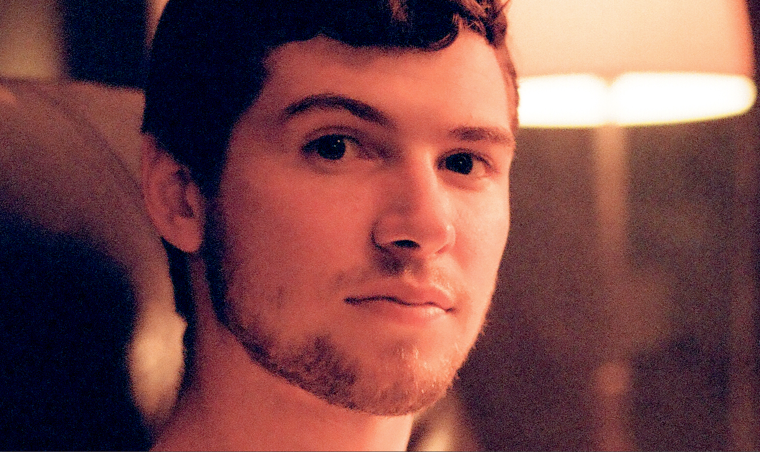

Methods: gaussian blur

Slide 9
Solution

